Slide 1


Autonomous Sailboat
European Project Semester
Roberto Giordano
Gizem Ozturk
Gary Jonathan Rabone
Marc Navarrete Hill
Imre Asztalos
Thies Gunther
T5
2015

Slide 2
Summary
Our Crew
Objective
State of the Art
Project Management
Marketing Analysis
Ethics & Deontology
Eco-efficacy measures for Sustainability
Project Development
Conclusion (Achievements and Future Work)
References & Bibliography
European Project Semester
T5
2015

Slide 3
Our Crew
Six Team Members
Interdisciplinary Fields
  Mechanical
  Electrical
  Industrial & Design
  Management
  Sales & Marketing
Mixed Cultures
  Languages
  Backgrounds
  Styles
1 Team
-------------
1 Goal
European Project Semester
T5
2015

Slide 4
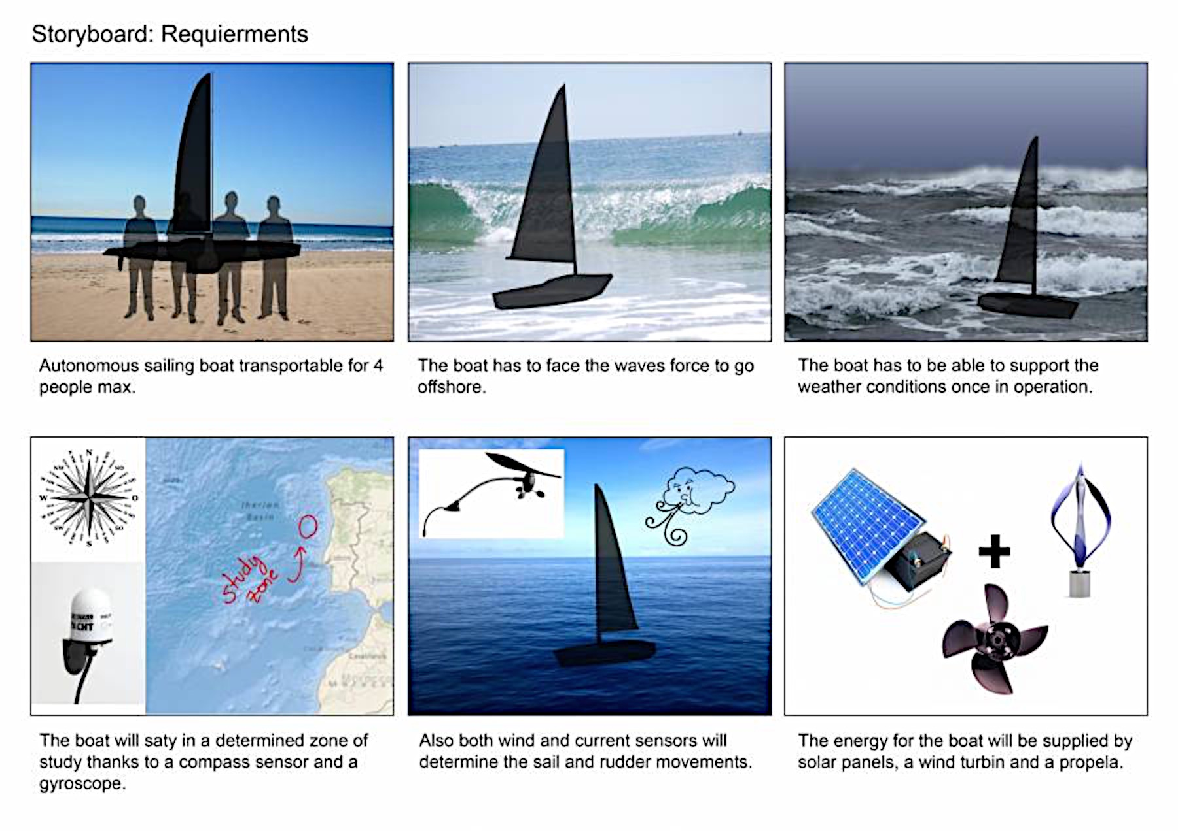
Objective
European Project Semester
T5
2015

Slide 5

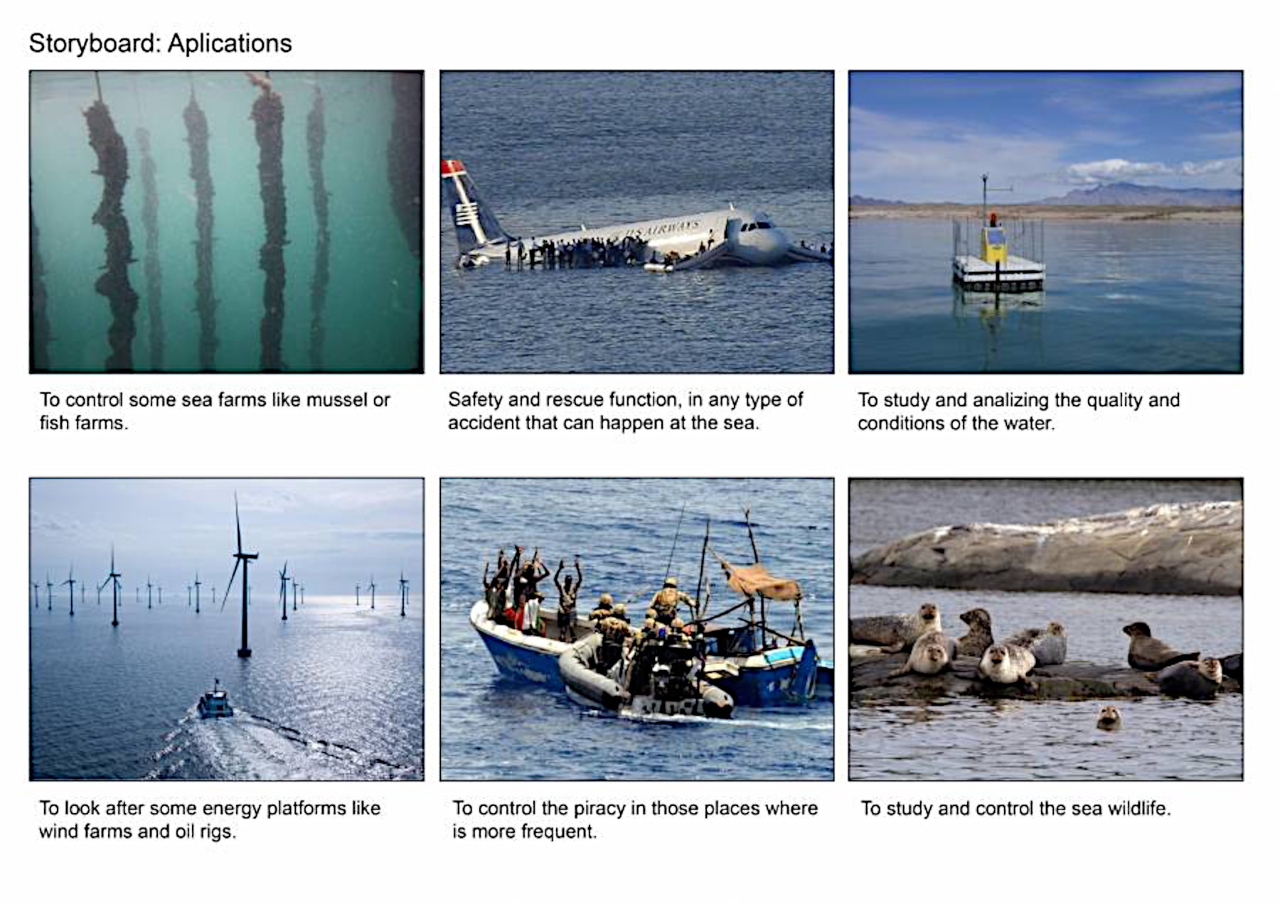
Objective
European Project Semester
T5
2015

Slide 6
State of the Art
Components of our Boat
  Hull
  Keel
  Rudder
  Mast
  Rigid Wing-sail
  Comprehend Electrical Devices
    Systems
    Wind sensor
    Batteries
    Solar panel
European Project Semester
T5
2015

Slide 7
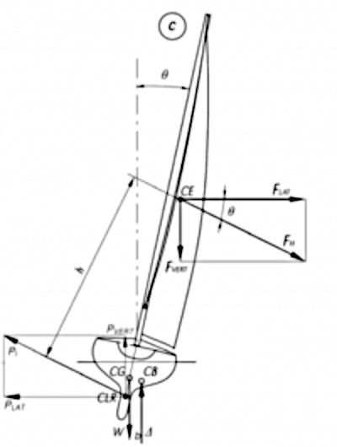
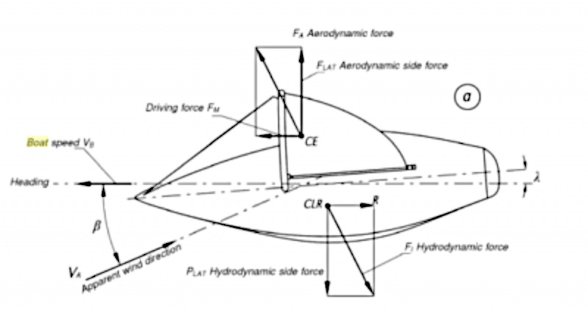
State of the Art
Mechanical Principles
  Hydrostatics
    Buoyancy
      Stability
      Centre of Gravity
  Aerodynamics
  Dynamics & Static Equilibrium
European Project Semester
T5
2015

Slide 8
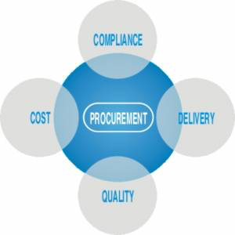
Project Management
Scope
Budgeting
Risk
People/Communication
Stakeholders
European Project Semester
T5
2015

Slide 9



Marketing Analysis
PEST ANALYSIS
Competitors
Segmentation
  Business 2 Business
    R&D – Security – Fish Farms – Renewable Energy – Climate Change
Political : EU Maritime Growth | Economic : R&D in Renewables
Social : Climate Change | Technological : Marine/Robotic
European Project Semester
T5
2015

Slide 10
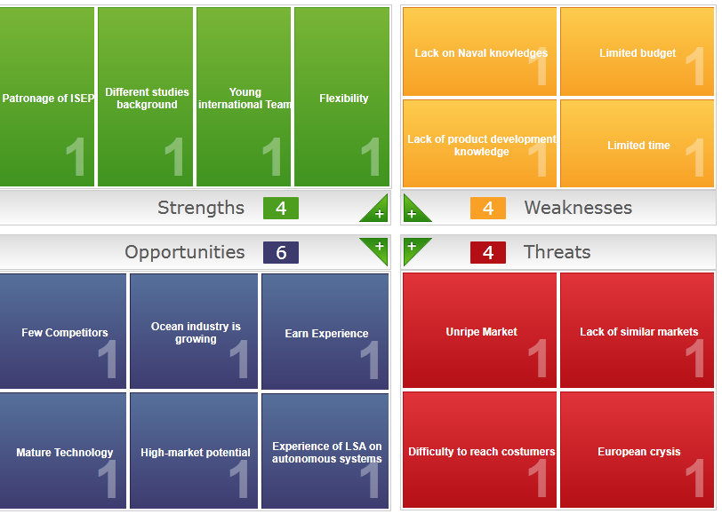
Marketing Analysis
SWOT ANALYSIS
European Project Semester
T5
2015

Slide 11
Ethics & Deontology
General Code of Conduct:
Environmental
Engineering
Sales & Marketing
Academic
Liability
European Project Semester
T5
2015

Slide 12
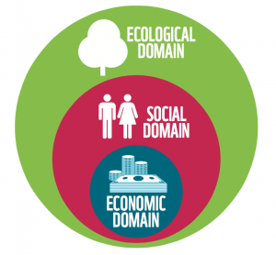
Eco-efficacy Measures for Sustainability
European Project Semester
Life Cycle Analysis
Raw Material
Design
Manufacture
Distribution
Use
Disposal
T5
2015

Slide 13
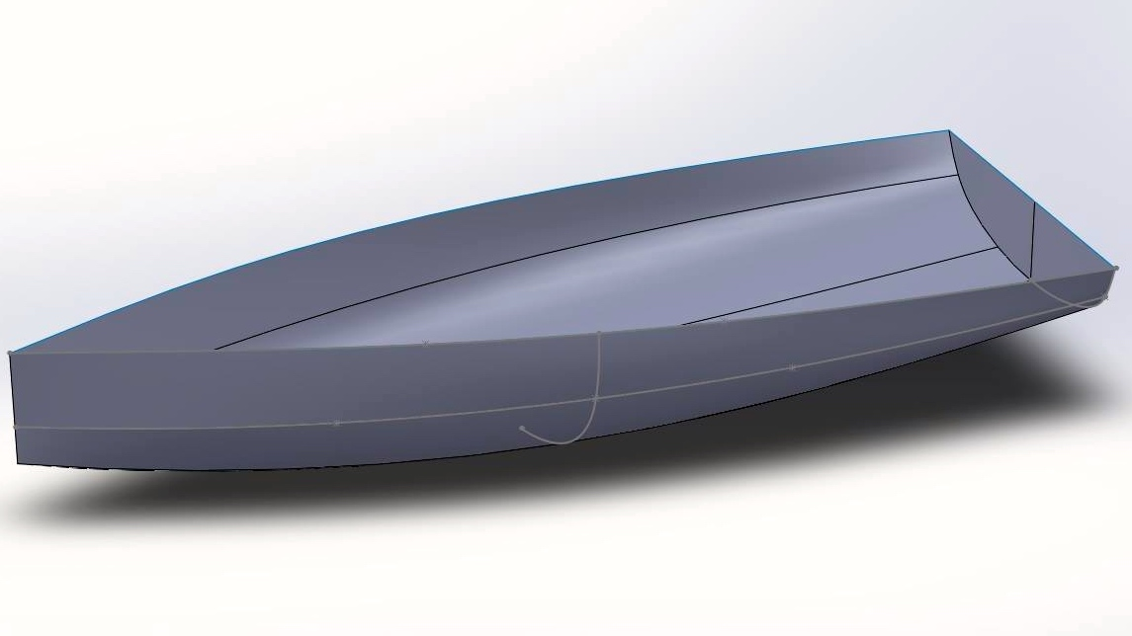
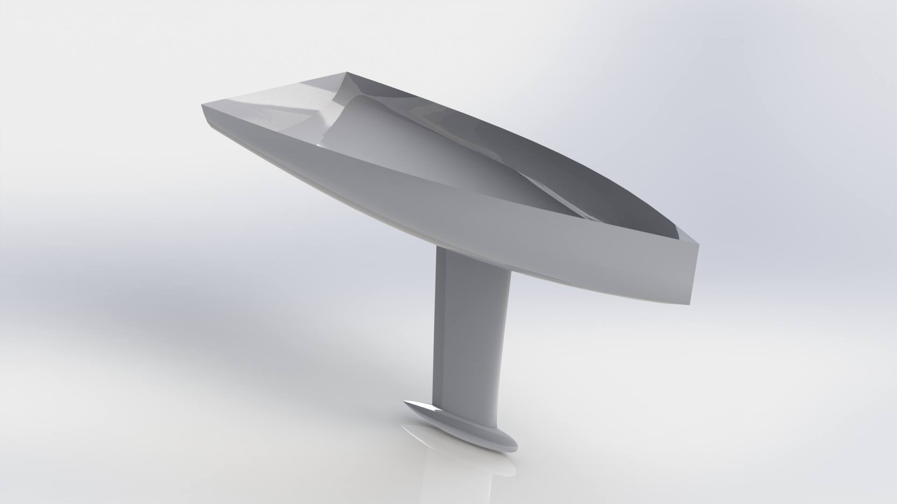
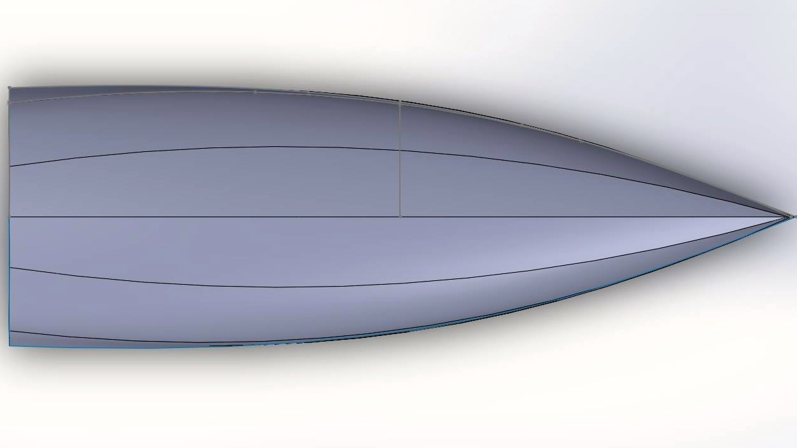
Project Development
Monohull w/ Rigid Wing-Sail
Calculations
Design – Hull & Keel
European Project Semester
T5
2015

Slide 14
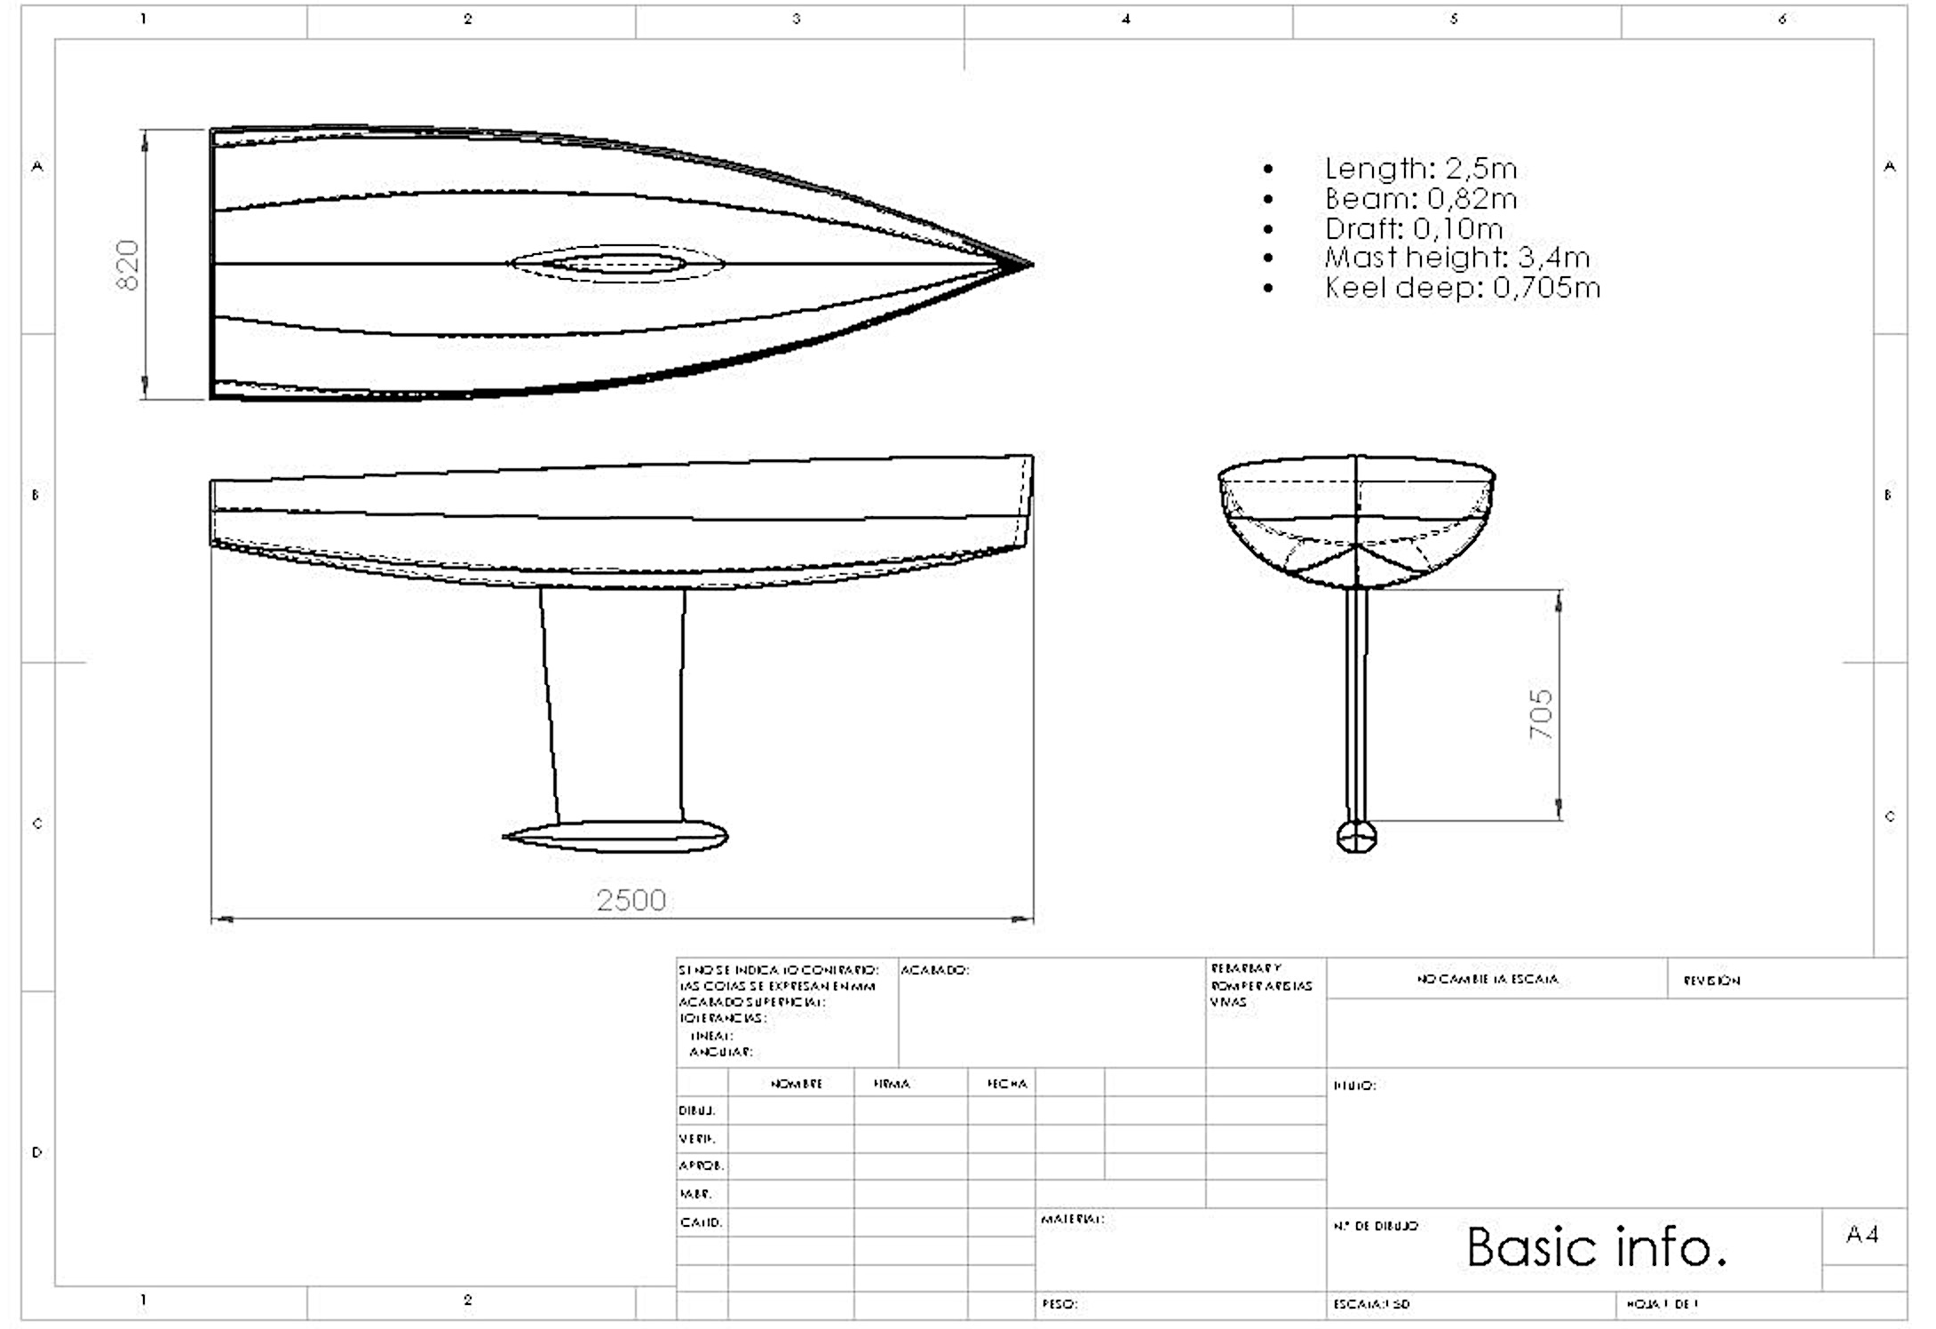
Project Development
Blueprints
Material – Yet to be distinguished
European Project Semester
T5
2015

Slide 15
Conclusion
Achievements:
State of the Art
  Advanced knowledge of boat design and mechanical principles
Boat architecture established
Finalised Market Analysis, Sustainability Measures and Ethical Concerns
Future Recommendations/Developments:
Complete viable calculations and select/purchase materials
Develop a manufacturing plan for both model and final product
Conduct functional tests
European Project Semester
Thanks for Listening
Any Questions?
T5
2015

Slide 16
References & Bibliography
[1] Green Report http://www.greenreport.it/_archivio2009/index.php?page=default&id=7141.
[2] National Geographic Center http://noc.ac.uk/about-us/about-us
[3] Aero-hydrodynamics and the Performance of Sailing Yachts:The Science Behind Sailing Yachts and their Design;Fabio Fossati;2009;Page 325
[4] http://www.nspe.org/resources/ethics/code-ethics; [Accessed 5th April 2015]
[5] http://www.gizmag.com/solar-power-linux-brain-autonomous-robot-sailboat-aims-to-conquer-the-atlantic/10517/; [Accessed 5th April 2015]
[6] http://www.roboat.at/en/presse/; [Accessed 5th April 2015]
[7] http://sailing.about.com/od/typesofsailboats/ss/Ruddertypes_5.htm#step-heading; [Accessed 3rd April 2015]
[8] Technologies for Autonomous Sailing: Wings and Wind Sensors http:// bit.ly/ 1BrsSAs
[9] Larsson, Ralf and Eliasson, Principle of Yacht Design, 2000
European Project Semester
T5
2015

